Slide 1
Srujana
The Watson Chatbot from Eidiko

Slide 2
What is it?
Chatbots are the new, 24X7 face of customer service.
Contact Centre needs to tap fully into this opportunity to leverage on customer service and innovation.

Slide 3
Objective
To help in effectively transfer the load of customer queries from Voice to non-voice channels (Website, Chat, IM, Social Media and etc).
The Chatbot should help in reducing the number of calls for basic but frequent queries.

Slide 4
Technology
Java 1.8
Watson API
IBM Cloud functions
RESTful services
Ajax
jQuery UI
Bootstrap3
HTML , CSS , JS

Slide 5
Actual Requirement
Support Bot (Stage 1)
Sales Bot (Stage 2)
Feedback Bot (Stage 3)
Training Bot (Stage 4)
Complaint Management Bot (Stage 5)

Slide 6
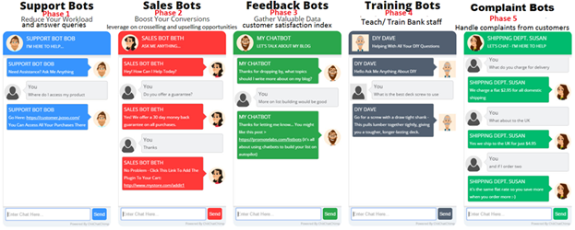
Chatbots

Slide 7
POC Theme
We have developed a use case , support Bot for Bank Account opening for all Customers.

Slide 8
Demo Time

Slide 9
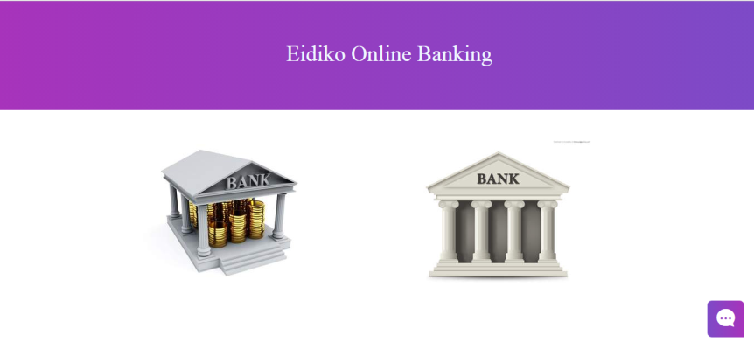
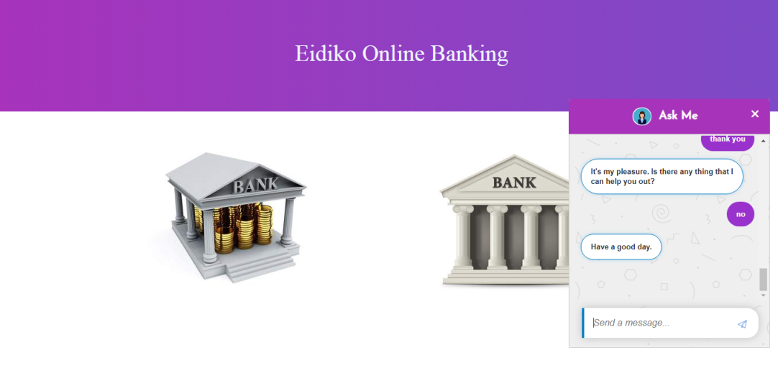

Slide 10
Additional Features
Validations
Expressions
Search Skill
Speech Recognition/Audio Support
Chat history as logs

Slide 11
About IBM Watson

Slide 12
Any Queries ?

Slide 13
Thank you

